Slide 1
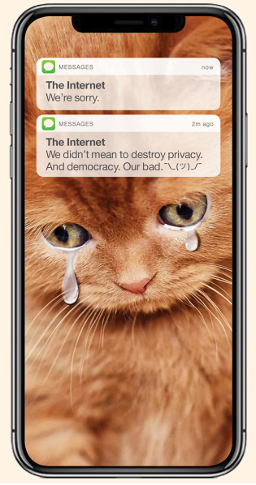
Digital Humanism in Vienna
Potentials for an initiative

Slide 2
1) What‘s the issue?
2) A Vienna profile: Digital Humanism
3) Vienna Manifesto on Digital Humanism

Slide 3
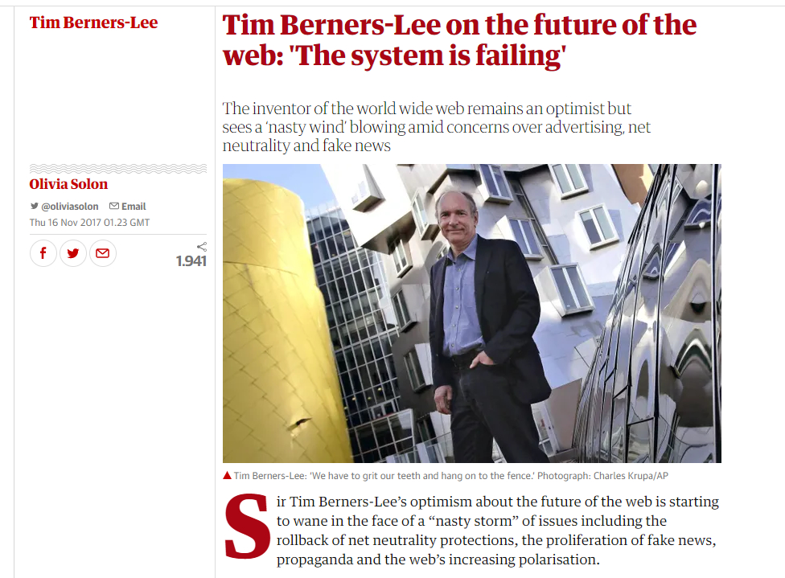
1) WHAT IS THE issue WITH DIGITALIZATION?
Computer scientists join the criticism of digitalization that has largely come from the humanities (and mostly have been outsiders)
Tim Berners Lee (inventor of the web) diagnosed: “The system is failing!”
Increasing polarization in the web
Increasingly powerful gatekeepers
Misinformation, propaganda, fake news by behavioural micro-targeting and “weaponized AI propaganda”

Slide 4
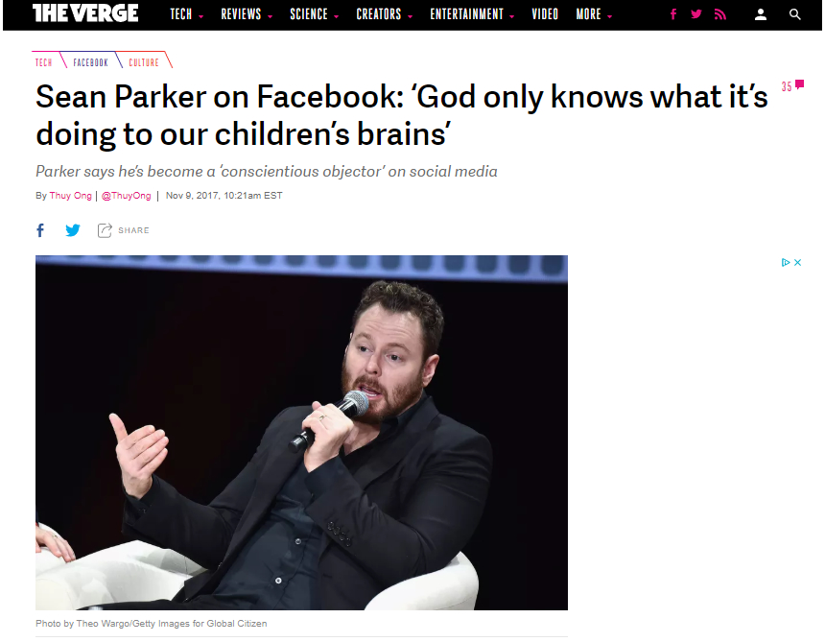
1) WHAT IS THE issue WITH DIGITALIZATION?
Sean Parker (1st president of Facebook)
„To keep the internet free — while becoming richer, faster, than anyone in history — the technological elite needed something to attract billions of users to the ads they were selling. And that something, it turns out, was outrage.”
(Noah Kulwin, New York Magazine)

Slide 5
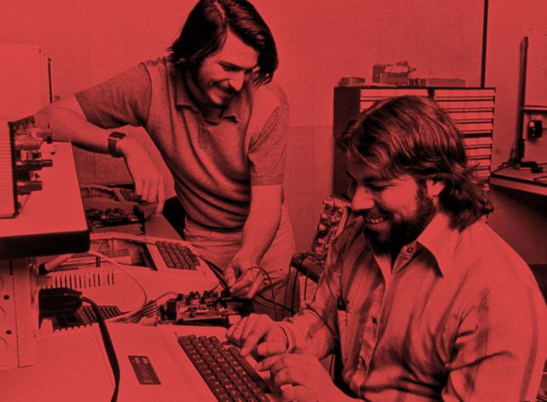
1) WHAT IS THE issue WITH DIGITALIZATION?
The problem is not that a per se neutral technology has been misused by big tech companies but that the system has been designed in a way that incorporated the – some say naive – moral, economic, societal assumptions of their designers:
The “information wants to be free” paradigm → avoid to pay for information while becoming rich at the same time (paying with user data through ads)
Bypassing (or even destroying) existing societal institutions by imagining a individualized peer-to-peer society (e.g. with cryptocurrencies as it latest instalment)
Vardi, M. How the Hippies Destroyed the Internet, DOI:10.1145/3226073
Kulwin, N. The Internet Apologizes …
http://nymag.com/intelligencer/2018/04/an-apology
-for-the-internet-from-the-people-who-built-it.html

Slide 6
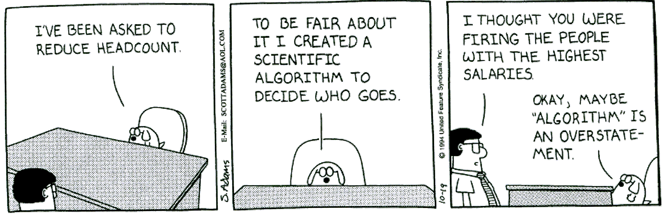
1) WHAT IS THE issue WITH DIGITALIZATION?
Further issues:
Delegation of decision making authority to algorithms
  … and simultaneously regarding them as “unbiased”
  Further fuelled by the expectations towards AI
Automation
  Skilled workforce replaced by machines

Slide 7
1) → 2) What to do?
The current system – while under criticism – is well in place and has become deeply entangled with society → we cannot simply get rid of it
So far, viable alternatives are not on the horizon
  A lot of experimentation on single aspects of the problems – in particular on the margins of the systems
  Alternatives spaces aren’t occupied by big players - yet → this opens up great potentials for new actors to position themselves
  Not unlike the climate catastrophe, single actors might change nothing on a global scale → however, there is a responsibility to contribute to the attempts to change the system
  ¯\_(ツ)_/¯ is not an option!

Slide 8
2) Digital Humanism as aN answer
What is it?
Today‘s technology has become a culture on a global scale and thus co-evolves with society and humanity.
complex network of humans and technology in which both have the capability to act
From computer-literate people to people-literate technologies

Slide 9
2) Digital Humanism as aN answer
Digital Humanism seeks to re-introduce human values to the core of our concerns:
  What is a good life and how might technologies help to realize it?
  The good life: Perhaps the No.1 topic for cities
Digital Humanism emphasizes that it is not primarily the impacts of technologies on society that should matter (because it might then already be too late) but their very design
  Reflexivity
  Trans- and Interdisciplinarity

Slide 10
2) Digital Humanism as a central narrative for Vienna as “Digital Capital of Europe”
Digital Humanism offers a great opportunity for Vienna to develop its own distinctive yet connected narrative in the digital era
  No 101st Silicon Valley
  Vienna can refer to its political and intellectual traditions to account for the values encompassed in Digital Humanism
    Tying in the traditions of the Vienna Circle combining philosophers, social and natural scientists with impact until the present day
    Political traditions of “Red Vienna” which made Vienna one of the most liveable cities today

Slide 11
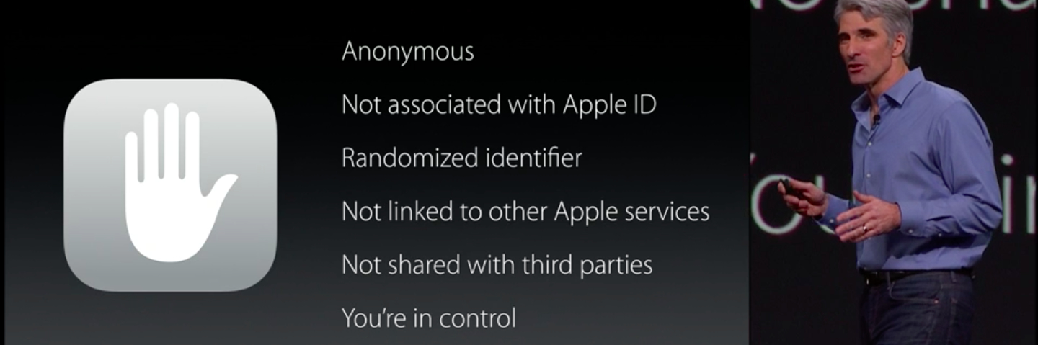
2) What does this Narrative offer to Vienna?
This narrative provides a unique selling proposition among the hundreds of other places selling themselves under the label digital city
Thereby it can attract thinkers and researchers that do not find the realisation of humanistic values in their places → more and more of these people can be found in companies like FB, Google et al.
It’s a future investment. Mid- to long-term, Vienna can become an attractive place for companies that value humanistic values such as privacy

Slide 12
2) Study to identify potentials in vienna
Explorative study commissioned by City of Vienna
Will be presented by Katja Mayer in a few minutes
Considerable potential, but also some gaps

Slide 13
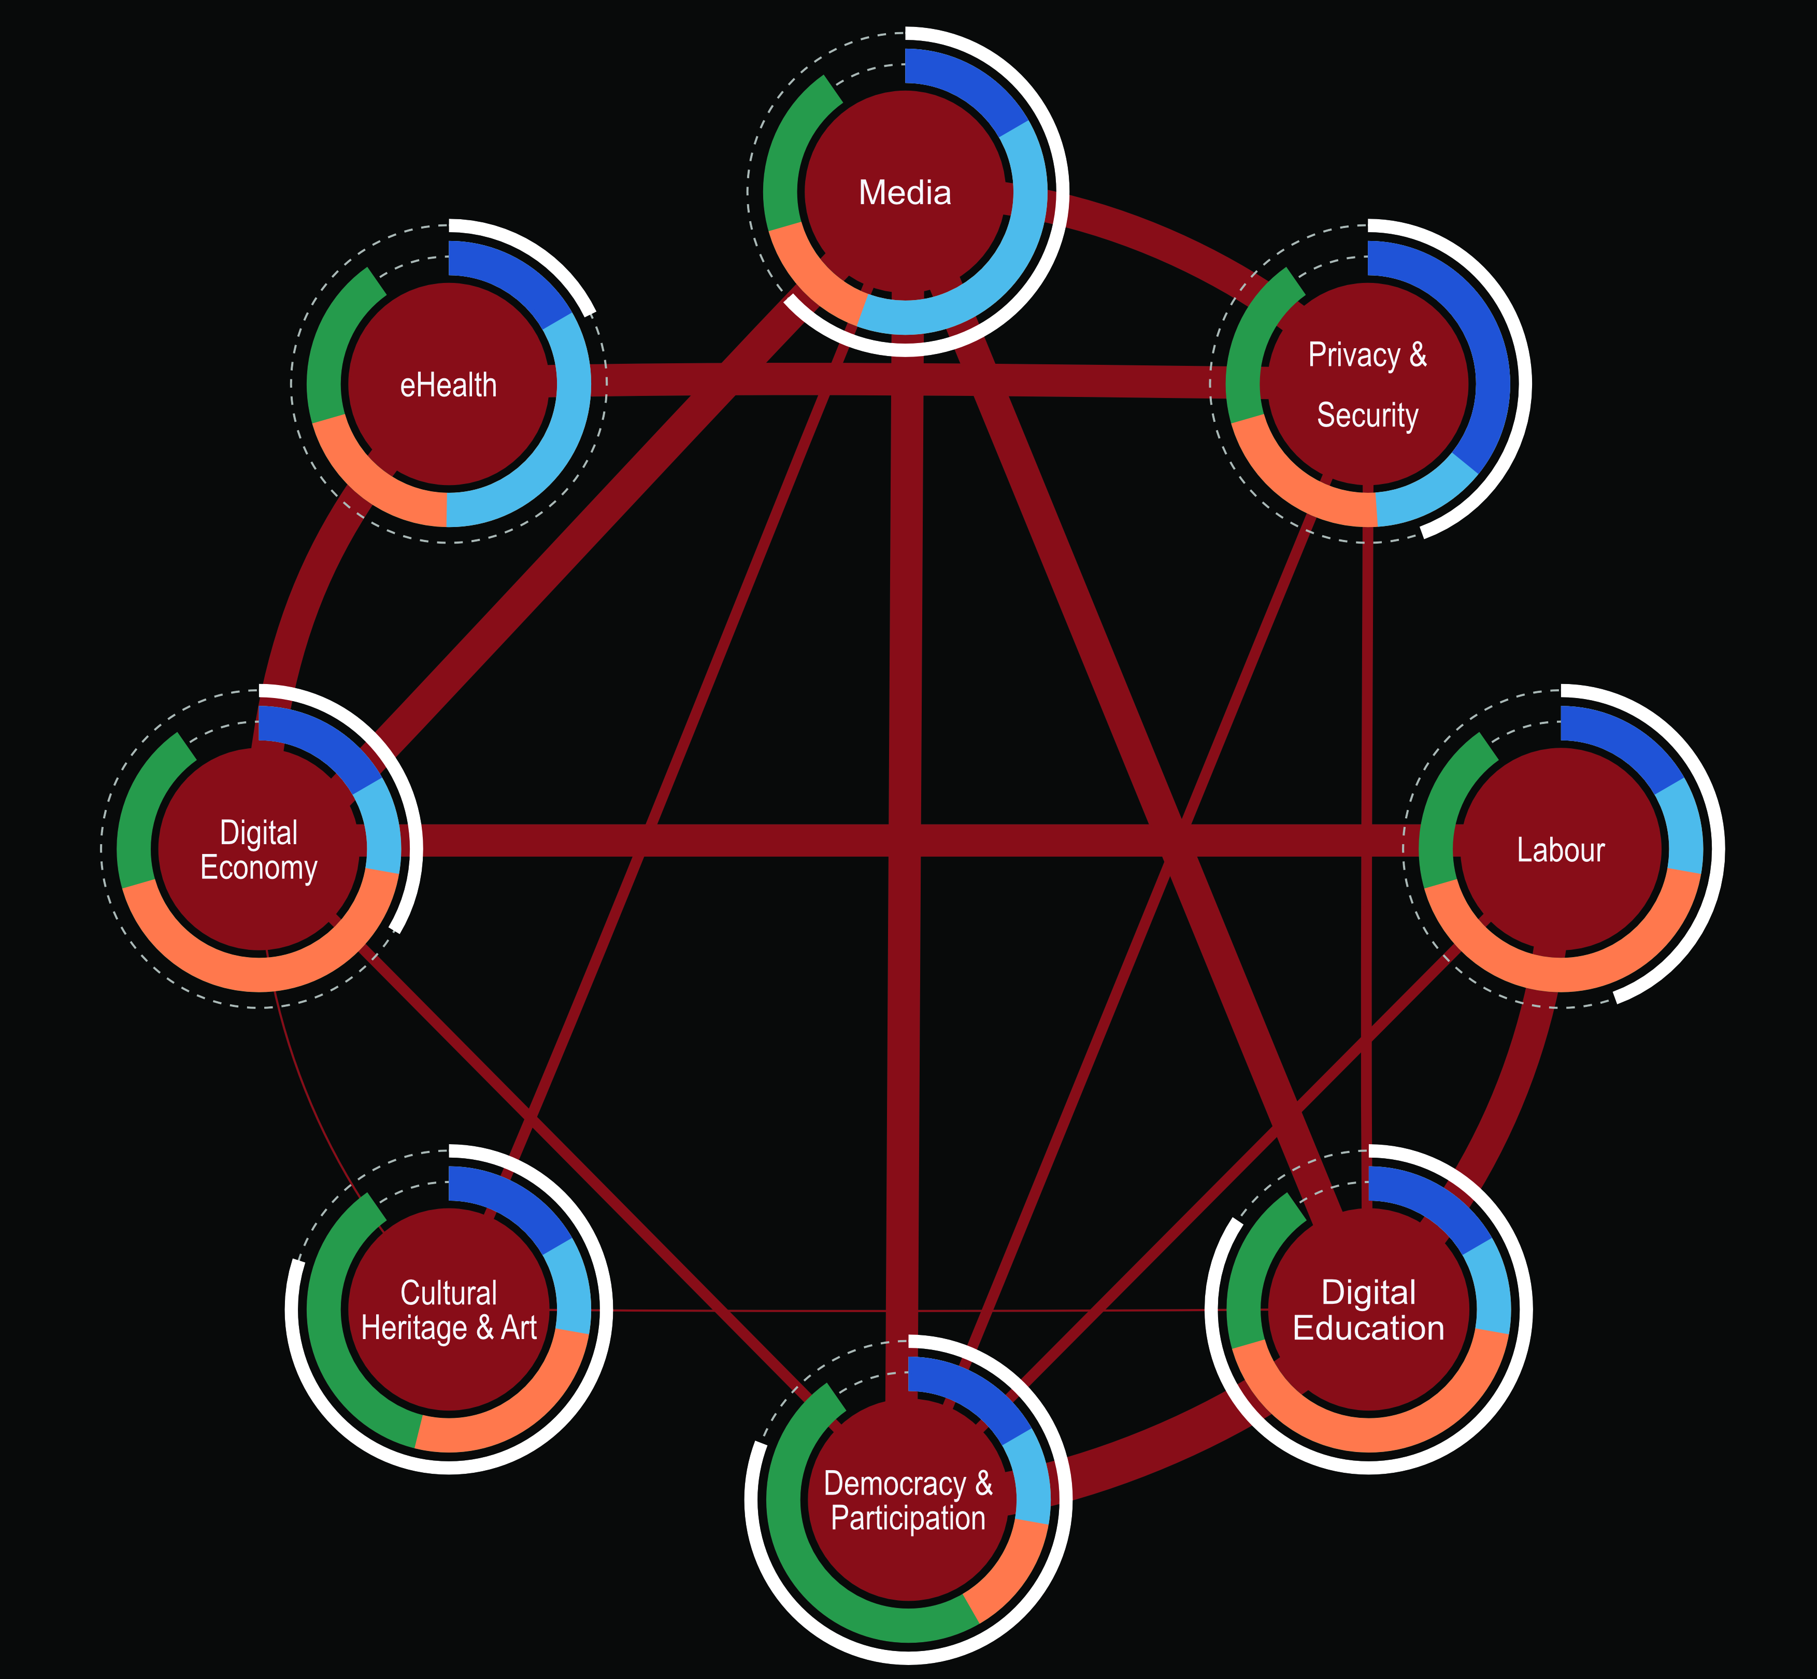
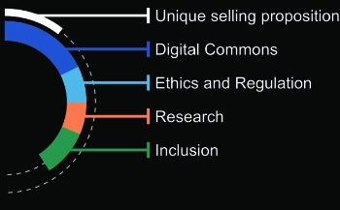

Slide 14
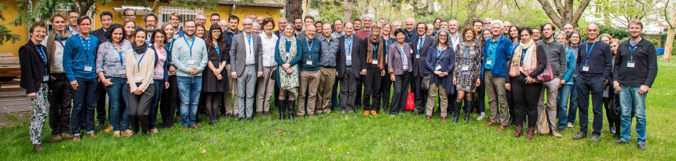
3) Vienna Manifesto on Digital Humanism
Discussions triggered by actors in Vienna led to an international workshop at TU Vienna on Digital Humanism in April 2019
Local and international participants; ICT and SSH → impressively demonstrated the unease about current developments both in computer science and in society with regard to digitalization
Outcome: an international manifesto that is strongly endorsed by computer science societies (e.g. Informatics Europe); will also be published in ACM Communications

Slide 15
3) Vienna Manifesto on Digital Humanism
https://www.informatik.tuwien.ac.at/dighum/wp-content/uploads/2019/05/manifesto.pdf
Principles
Digital technologies should be designed to promote democracy and inclusion.
Privacy and freedom of speech are essential values for democracy and should be at the center of our activities.
Effective regulations, rules and laws, based on a broad public discourse, must be established. / Regulators need to intervene with monopolies.
Decisions with consequences that have the potential to affect individual or collective human rights must continue to be made by humans.

Slide 16
3) Vienna Manifesto on Digital Humanism
Principles continued …
Scientific approaches crossing different disciplines are a prerequisite for tackling the challenges ahead.
Universities are the place where new knowledge is produced and critical thought is cultivated. / Academic and industrial researchers must engage openly with wider society and reflect upon their approaches.
Practitioners everywhere ought to acknowledge their shared responsibility for the impact of information technologies.
A vision is needed for new educational curricula, combining knowledge from the humanities, the social sciences, and engineering studies. / Education on computer science / informatics and its societal impact must start as early as possible.

